Slide 1
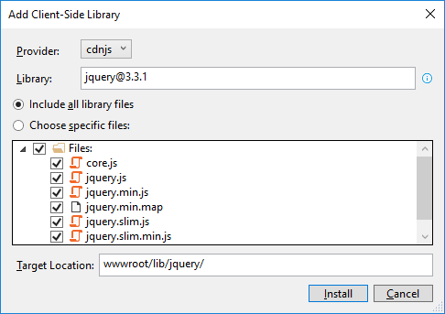
How to add the Bootstrap and jQuery libraries
Start Visual Studio and open a project. In the Solution Explorer, expand the wwwroot/lib folder and delete any old Bootstrap or jQuery libraries.
In the Solution Explorer, right-click on the project name and select the Add→Client-Side Library item.
In the dialog box that appears, “jquery@”, “popper.js”, “jquery-validate”, and “twitter-bootstrap”(but change the target location to “www/lib/bootstrap” for this one).

Slide 2
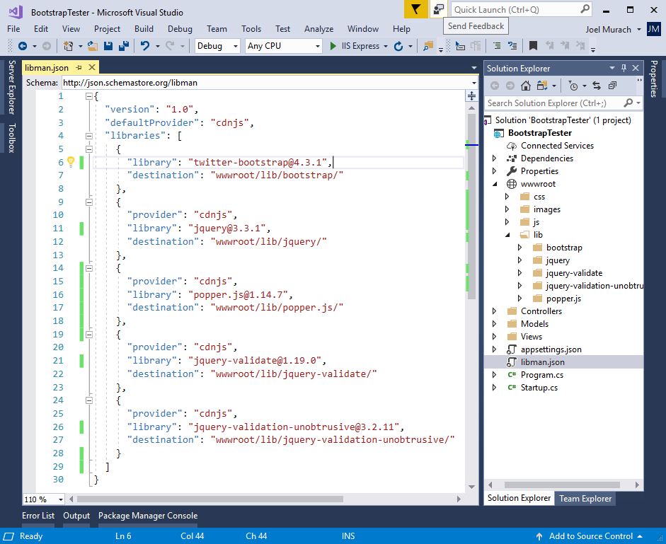
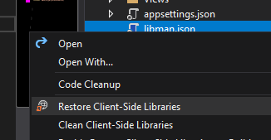
The libman.json file for the client-side libraries
Clean to delete
Restore to restore
(-> restores based on the dependencies written on the code)

Slide 3
A Razor layout that enables client-side libraries
<!DOCTYPE html>
<html>
<head>
<meta name="viewport" content="width=device-width" />
<title>@ViewData["Title"]</title>
<link rel="stylesheet"
href="~/lib/bootstrap/css/bootstrap.min.css" />
<link rel="stylesheet" href="~/css/custom.css" />
<script src="~/lib/jquery/jquery.min.js"></script>
<script src="~/lib/popper.js/popper.min.js"></script>
<script src="~/lib/bootstrap/js/bootstrap.min.js"></script>
<script src="~/lib/jquery-validate/
jquery.validate.min.js"></script>
<script src="~/lib/jquery-validation-unobtrusive/
jquery.validate.unobtrusive.min.js"></script>
</head>
<body>
@RenderBody()
</body>
</html>

Slide 4
An extra directory that may be included by the MVC template
<link rel="stylesheet"
href="~/lib/bootstrap/dist/css/bootstrap.min.css" />

Slide 5
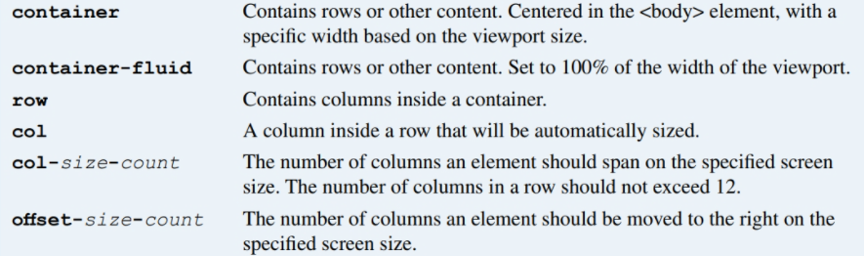
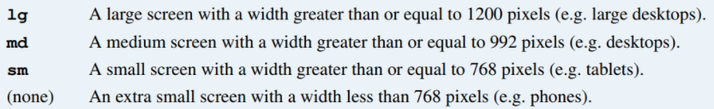
The URL for the Bootstrap documentation
https://getbootstrap.com/docs/
Valid Bootstrap class values
Valid size values

Slide 6
Two columns that are automatically sized
<div class="col">Column 1</div>
<div class="col">Column 2</div>
An element that spans four columns on medium and large screens
<div class="col-md-4">This element spans four columns</div>
An element that spans 4 columns on medium screens and 3 on large
<div class="col-md-4 col-lg-3">
This element spans three or four columns
</div>
An element that is moved one column to the right on medium screens
<div class="col-md-4 offset-md-1">
This element is offset by one column
</div>

Slide 7
The HTML for a grid
<main class="container">
<div class="row">
<div class="col-12">Column 1</div>
<div class="col-12">Column 2</div>
</div>
<div class="row">
<div class="col-md-4">Column 1</div>
<div class="col-md-8">Column 2</div>
</div>
<div class="row">
<div class="col-md-4 col-sm-6">Column 1</div>
<div class="col-md-8 col-sm-6">Column 2</div>
</div>
</main>

Slide 8
Custom CSS classes that override the Bootstrap CSS classes
.row { /* custom row styles */
margin-bottom: 0.5rem;
}
.row div { /* custom column styles */
border: 1px solid black;
padding: 0.5rem;
background-color: aliceblue;
}

Slide 9
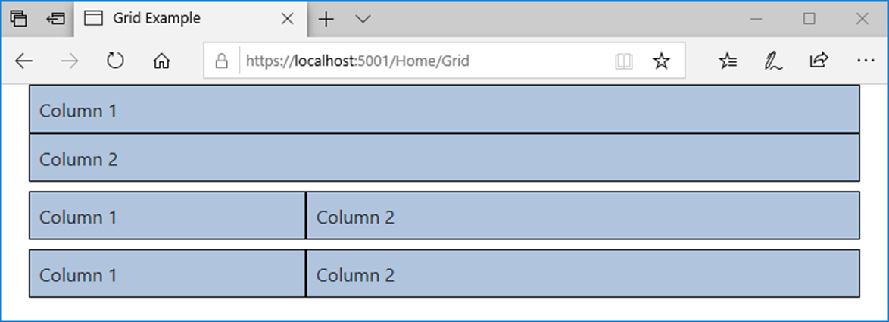
The Bootstrap grid on a medium screen

Slide 10
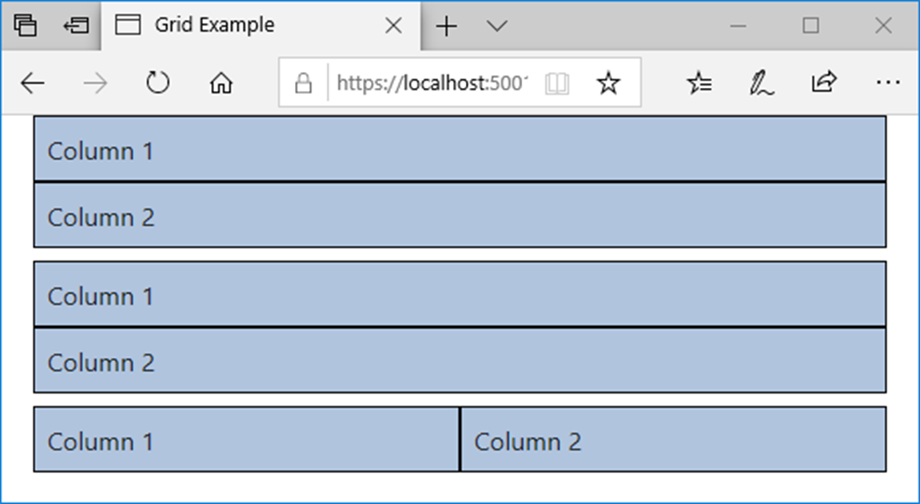
The Bootstrap grid on a small screen

Slide 11
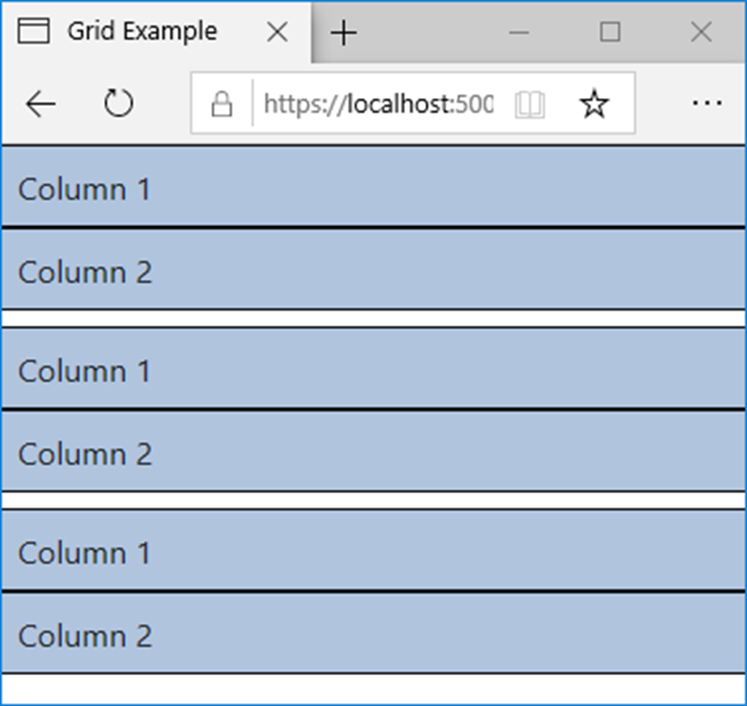
The Bootstrap grid on an extra small screen

Slide 12
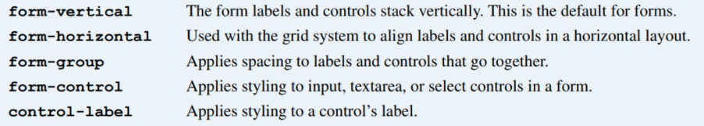
Bootstrap CSS classes for forms

Slide 13
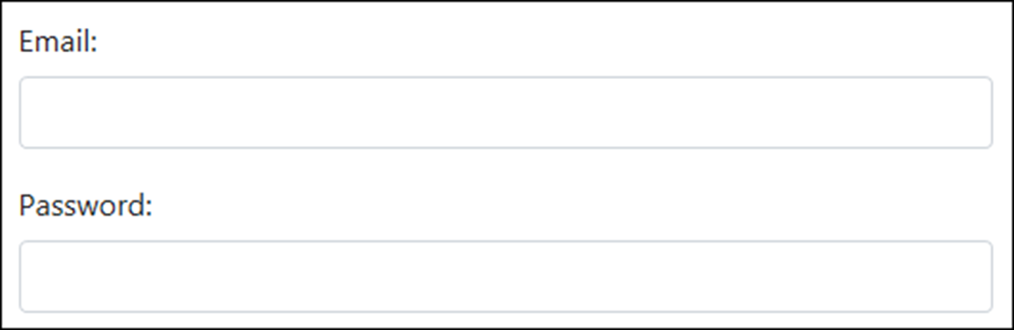
A form with two text boxes in vertical layout

Slide 14
The HTML for the form in vertical layout
<form asp-action="Login" method="post">
<div class="form-group">
<label for="email">Email:</label>
<input type="email" id="email" class="form-control" />
</div>
<div class="form-group">
<label for="pwd">Password:</label>
<input id="pwd" type="password" class="form-control" />
</div>
</form>

Slide 15
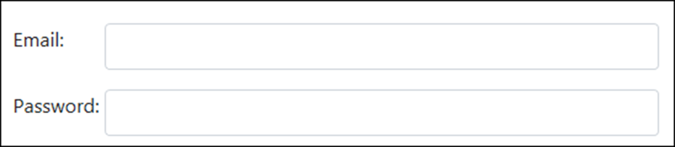
A form with two text boxes in horizontal layout

Slide 16
The HTML for the form in horizontal layout
<form asp-action="Login" method="post">
<div class="form-group row">
<label for="email" class="col-sm-2">Email:</label>
<div class="col-sm-10">
<input type="email" id="email" class="form-control" />
</div>
</div>
<div class="form-group row">
<label for="pwd" class="col-sm-2">Password:</label>
<div class="col-sm-10">
<input type="password" id="pwd" class="form-control" />
</div>
</div>
</form>

Slide 17
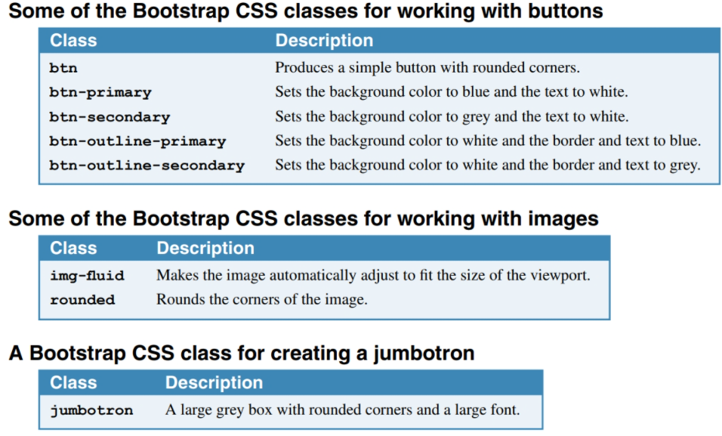

Slide 18
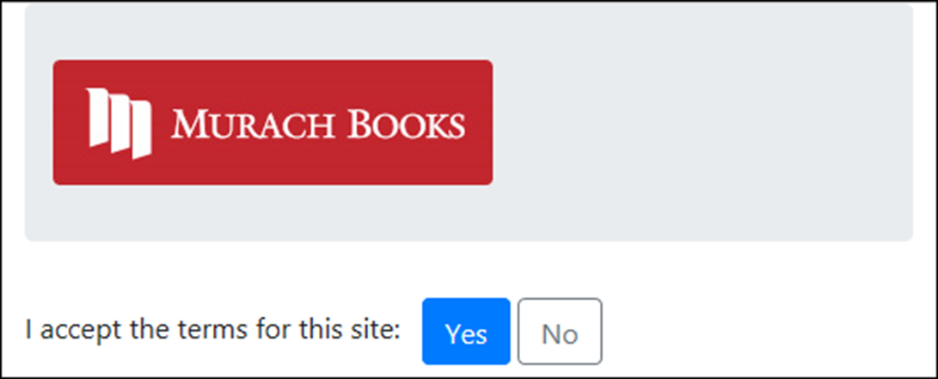
A jumbotron, an image, and two buttons

Slide 19
The HTML for the jumbotron, image, and buttons
<div class="container">
<header class="jumbotron">
<img id="logo" alt="Murach logo"
src="~/images/MurachLogo.jpg"
class="img-fluid rounded" />
</header>
<main>
<form asp-action="Index" method="post">
<span class="mr-2">I accept the terms for this site:
</span>
<button type="submit" class="btn btn-primary">
Yes
</button>
<button id="btnNo" class="btn btn-outline-secondary">
No
</button>
</form>
</main>
</div>

Slide 20
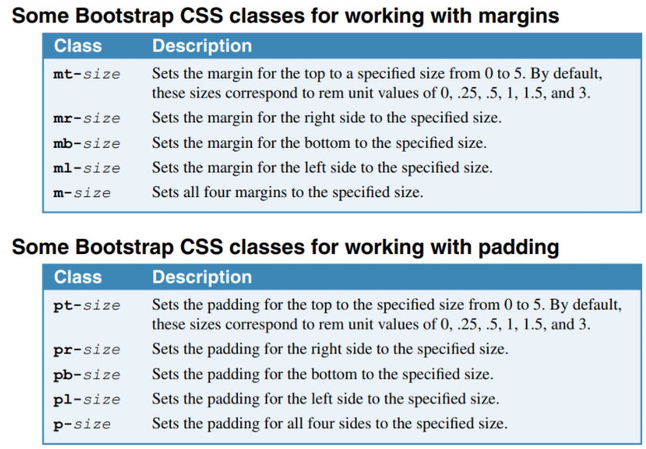

Slide 21
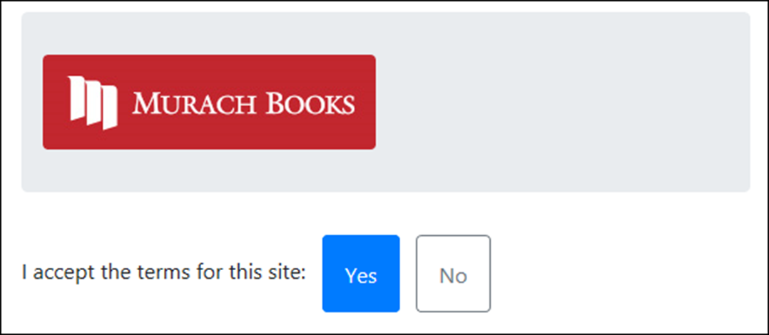
Some elements that use margins and padding

Slide 22
The HTML for the elements
<div class="container">
<header class="jumbotron mt-2">
<img id="logo" alt="Murach logo"
src="~/images/MurachLogo.jpg"
class="img-fluid rounded" />
</header>
<main>
<form asp-action="Index" method="post">
<span class="mr-2">
I accept the terms for this site:
</span>
<button type="submit"
class="btn btn-primary p-3 mr-2">Yes
</button>
<button id="btnNo"
class="btn btn-outline-secondary p-3">No
</button>
</form>
</main>
</div>

Slide 23
The code for the Index view (part 1)
@model FutureValueModel
@{
ViewBag.Title = "Future Value Calculator";
}
<div class="container">
<header class="jumbotron">
<img id="logo" alt="Murach logo"
src="~/images/MurachLogo.jpg"
class="img-responsive rounded" />
<h1 class="mt-3">@ViewBag.Title</h1>
</header>
<main>
<form asp-action="Index" method="post">
<div class="row form-group">
<label asp-for="MonthlyInvestment"
class="col-sm-3">Monthly Investment: </label>
<div class="col-sm-3">
<input asp-for="MonthlyInvestment"
class="form-control" />
</div>
<span asp-validation-for="MonthlyInvestment"
class="col text-danger"></span>
</div>

Slide 24
The code for the Index view (part 2)
<div class="row form-group">
<label asp-for="YearlyInterestRate"
class="col-sm-3">Yearly Interest Rate:
</label>
<div class="col-sm-3">
<input asp-for="YearlyInterestRate"
class="form-control" />
</div>
<span asp-validation-for="YearlyInterestRate"
class="col text-danger"></span>
</div>
<div class="row form-group">
<label asp-for="Years" class="col-sm-3">
Number of Years: </label>
<div class="col-sm-3">
<input asp-for="Years" class="form-control" />
</div>
<span asp-validation-for="Years"
class="col text-danger"></span>
</div>

Slide 25
The code for the Index view (part 3)
<div class="row form-group">
<label class="col-sm-3">Future Value:</label>
<div class="col-sm-3">
<input value="@ViewBag.FutureValue" readonly
class="form-control" />
</div>
</div>
<div class="row form-group">
<div class="col offset-sm-3">
<button type="submit" class="btn btn-primary">
Calculate</button>
<a asp-action="Index"
class="btn btn-outline-secondary">Clear</a>
</div>
</div>
</form>
</main>
</div>

Slide 26
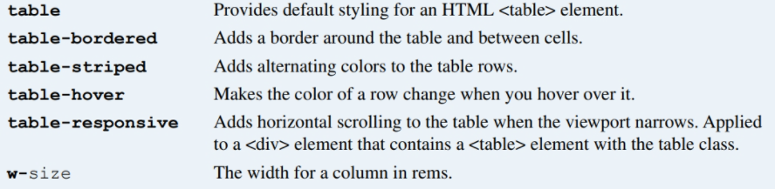
CSS classes for working with HTML tables

Slide 27
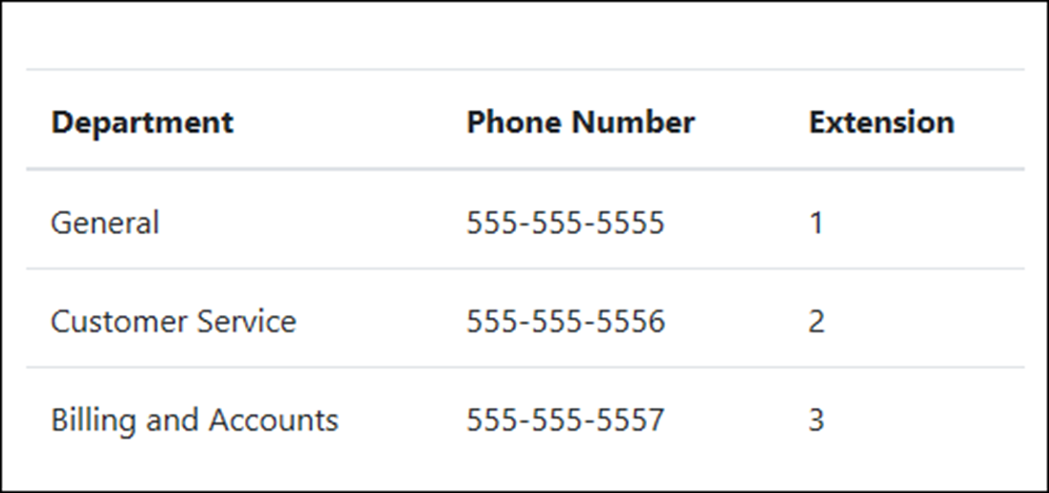
A table with default styling

Slide 28
The HTML for the table
<table class="table">
<thead>
<tr>
<th>Department</th>
<th>Phone Number</th>
<th>Extension</th></tr>
</thead>
<tbody>
<tr>
<td>General</td>
<td>555-555-5555</td>
<td>1</td></tr>
<tr>
<td>Customer Service</td>
<td>555-555-5556</td>
<td>2</td></tr>
<tr>
<td>Billing and Accounts</td>
<td>555-555-5557</td>
<td>3</td></tr>
</tbody>
</table>

Slide 29
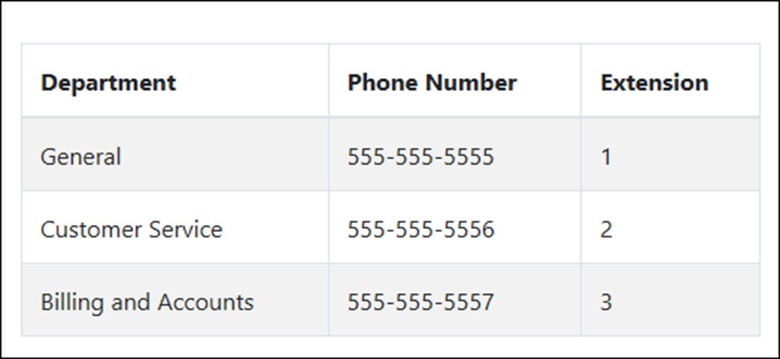
A table with alternating stripes and borders
The HTML for the table
<table class="table table-striped table-bordered table-hover">...

Slide 30
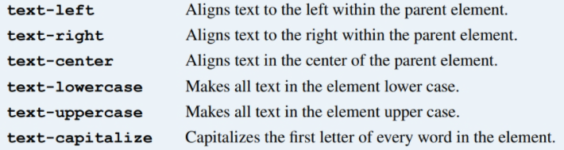
Common CSS classes for text

Slide 31
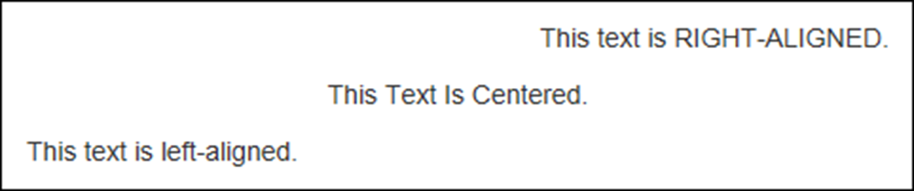
Some examples of the text CSS classes
The HTML for the text
<p class="text-right">
This text is <span class="text-uppercase">
right-aligned</span>.
</p>
<p class="text-center">
<span class="text-capitalize">This text is centered.
</span>
</p>
<p class="text-left">
This text is <span class="text-lowercase">
LEFT-ALIGNED</span>.
</p>

Slide 32
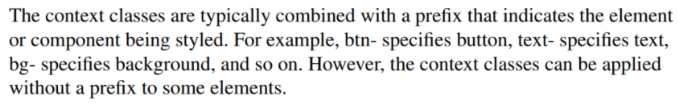
The context classes available to most elements
Class Default color
primary Dark blue
secondary Gray
success Green
info Light blue
warning Orange
danger Red
light White
dark Gray

Slide 33
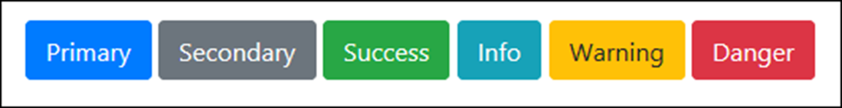
Some of the context classes applied to buttons
The HTML for the buttons
<button class="btn btn-primary">Primary</button>
<button class="btn btn-secondary">Secondary</button>
<button class="btn btn-success">Success</button>
<button class="btn btn-info">Info</button>
<button class="btn btn-warning">Warning</button>
<button class="btn btn-danger">Danger</button>

Slide 34
The success class applied to the text of an element
The HTML for the element
<p class="text-success">
Congratulations! You are now registered.
</p>

Slide 35

The warning class applied to the background of an element
The HTML for the element
<p class="bg-warning p-2 rounded">
Warning! Some required fields are empty.
</p>

Slide 36
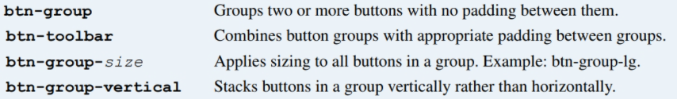
Common CSS classes for creating button groups

Slide 37
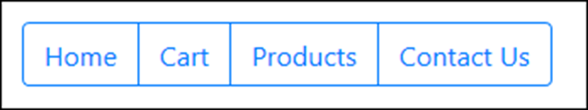
A basic button group
The HTML for the button group
<div class="btn-group" role="group"
aria-label="Button group">
<a href="/" class="btn btn-outline-primary">Home</a>
<a href="/cart" class="btn btn-outline-primary">
Cart</a>
<a href="/products" class="btn btn-outline-primary">
Products</a>
<a href="/contact-us" class="btn btn-outline-primary">
Contact Us</a>
</div>

Slide 38
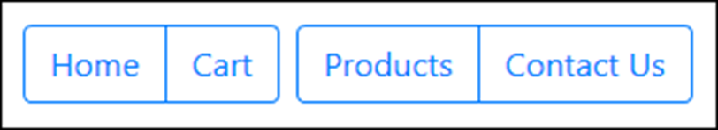
A toolbar with two button groups
The HTML for the button groups
<div class="btn-toolbar" role="toolbar"
aria-label="Toolbar with groups">
<div class="btn-group mr-2" role="group"
aria-label="First group">
<a href="/" class="btn btn-outline-primary">Home</a>
<a href="/Cart" class="btn btn-outline-primary">Cart</a>
</div>
<div class="btn-group" role="group" aria-label="Second group">
<a href="/products" class="btn btn-outline-primary">
Products</a>
<a href="/contact-us" class="btn btn-outline-primary">
Contact Us</a>
</div>
</div>

Slide 39
The URL for the Font Awesome website
https://fontawesome.com/
A typical <link> element that enables Font Awesome icons
<link rel="stylesheet"
href="https://use.fontawesome.com/releases/v5.8.1/css/all.css"
integrity="sha-long-hash_code" crossorigin="anonymous">

Slide 40

A button group that includes icons for its buttons
The HTML for the button group
<div class="btn-group" role="group"
aria-label="Button group">
<a href="/" class="btn btn-outline-primary">
<span class="fas fa-home"></span>&nbsp;Home&nbsp;
</a>
<a href="/cart" class="btn btn-outline-primary">
<span class="fas fa-shopping-cart"></span>
&nbsp;Cart&nbsp;
</a>
</div>

Slide 41
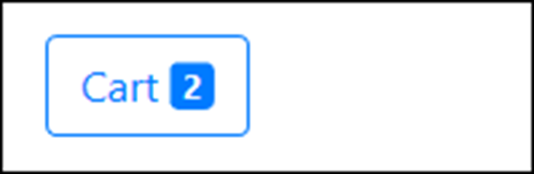
A button with a badge
The HTML for the button
<a href="/cart" class="btn btn-outline-primary">
&nbsp;Cart&nbsp;
<span class="badge badge-primary">2</span>
</a>

Slide 42
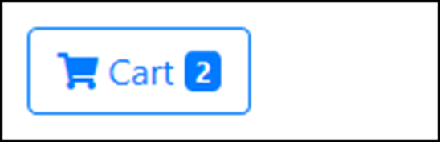
A button with an icon and a badge
The HTML for the button
<a href="/cart" class="btn btn-outline-primary">
<span class="fas fa-shopping-cart">
</span>&nbsp;Cart&nbsp;
<span class="badge badge-primary">2</span>
</a>

Slide 43
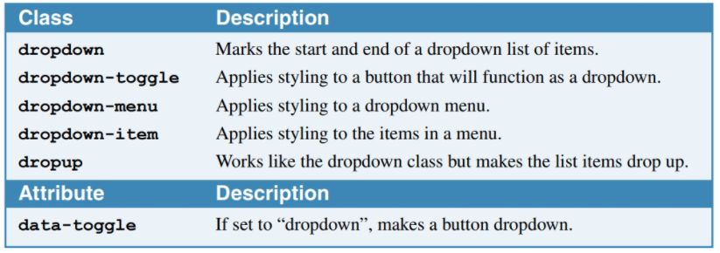
CSS classes for creating button dropdowns

Slide 44
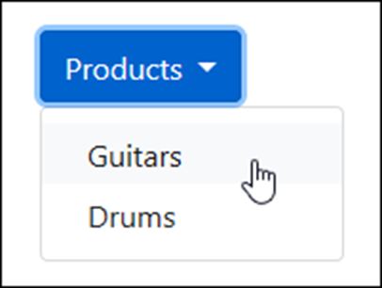
A button dropdown
The HTML for the button dropdown
<div class="dropdown">
<button type="button" class="btn btn-primary dropdown-toggle"
id="productsDropdown" data-toggle="dropdown"
aria-haspopup="true" aria-expanded="false">Products
</button>
<div class="dropdown-menu" aria-labelledby="productsDropdown">
<a class="dropdown-item"
href="/product/list/guitars">Guitars</a>
<a class="dropdown-item"
href="/product/list/drums">Drums</a>
</div>
</div>

Slide 45
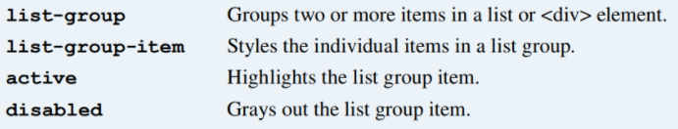
Common CSS classes for creating list groups

Slide 46
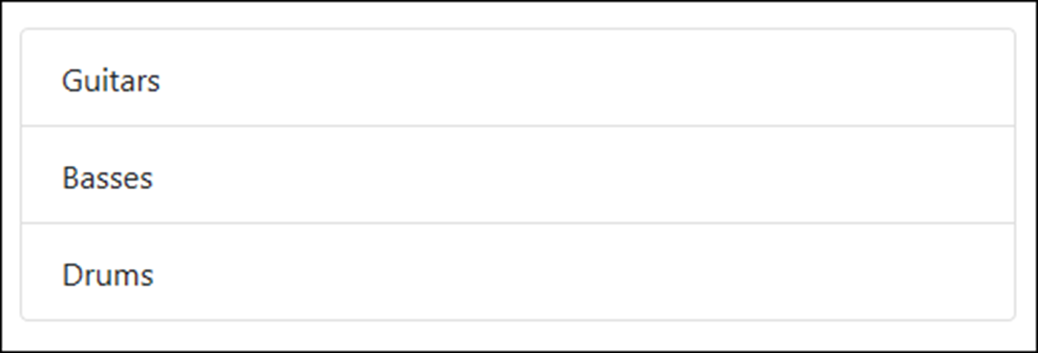
A basic list group
The HTML for the list group
<ul class="list-group">
<li class="list-group-item">Guitars</li>
<li class="list-group-item">Basses</li>
<li class="list-group-item">Drums</li>
</ul>

Slide 47
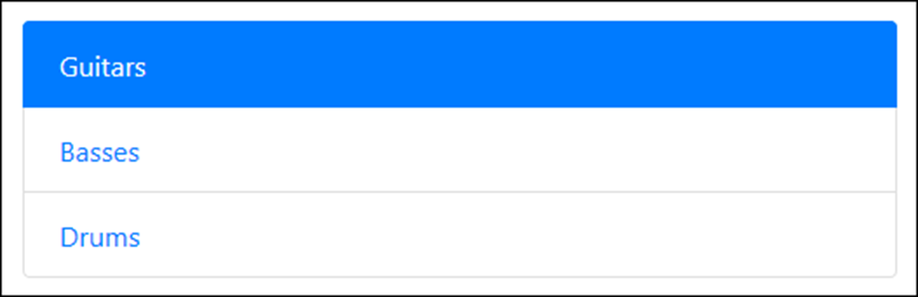
Another basic list group with an active item
The HTML for the list group
<div class="list-group">
<a href="/guitars" class="list-group-item active">
Guitars</a>
<a href="/basses" class="list-group-item">Basses</a>
<a href="/drums" class="list-group-item">Drums</a>
</div>

Slide 48
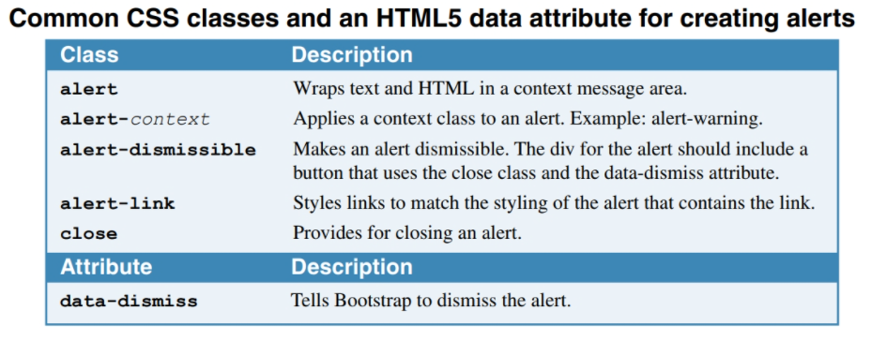

Slide 49
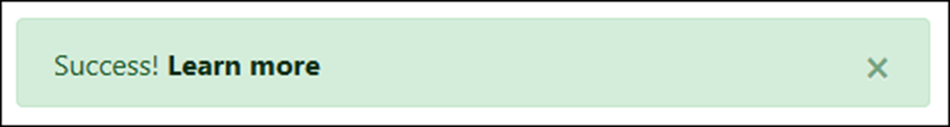
A dismissible alert with a link
The HTML for the alert
<div class="alert alert-success alert-dismissible">
<button class="close" data-dismiss="alert">
&times;
</button>
Success! <a href="#" class="alert-link">
Learn more</a>
</div>

Slide 50
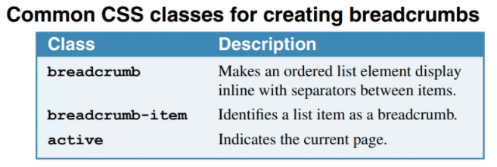

Slide 51
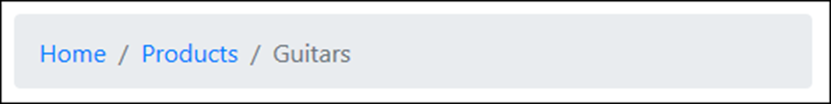
A breadcrumb with three segments
The HTML for the breadcrumb
<nav aria-label="breadcrumb">
<ol class="breadcrumb">
<li class="breadcrumb-item">
<a href="/">Home</a>
</li>
<li class="breadcrumb-item">
<a href="/Products">Products</a>
</li>
<li class="breadcrumb-item active"
aria-current="page">Guitars
</li>
</ol>
</nav>

Slide 52
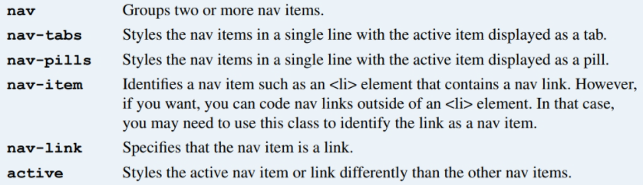
Common CSS classes for creating navs

Slide 53
Nav links styled as tabs
The HTML for the nav links
<nav class="nav nav-tabs">
<a class="nav-item nav-link active" href="/">Home</a>
<a class="nav-item nav-link" href="/products">
Products</a>
<a class="nav-item nav-link" href="/cart">Cart</a>
</nav>

Slide 54
The same nav links styled as pills
The HTML for the nav links
<nav class="nav nav-pills">
<a class="nav-item nav-link active" href="/">Home</a>
<a class="nav-item nav-link" href="/products">
Products</a>
<a class="nav-item nav-link" href="/cart">Cart</a>
</nav>

Slide 55
A more verbose way of coding the same nav links
<ul class="nav nav-pills">
<li class="nav-item">
<a class="nav-link active" href="/">Home</a>
</li>
<li class="nav-item">
<a class="nav-link" href="/products">Products</a>
</li>
<li class="nav-item">
<a class="nav-link" href="/cart">Cart</a>
</li>
</ul>

Slide 56
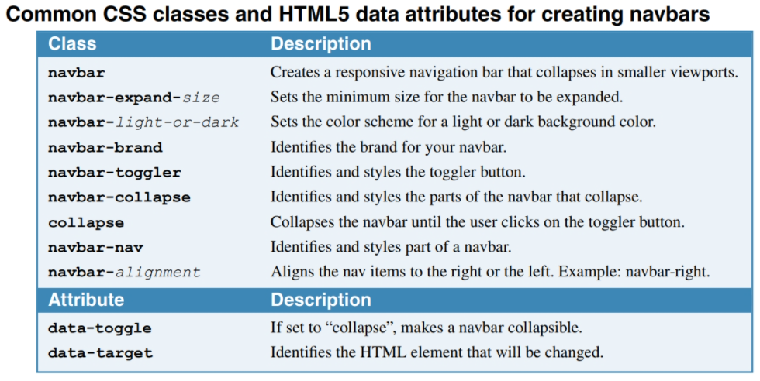
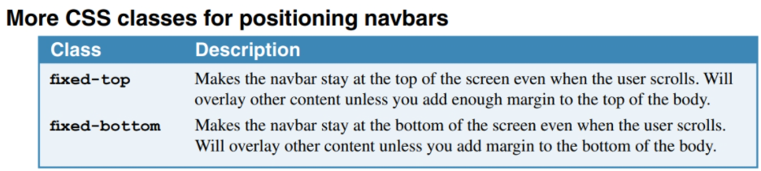

Slide 57
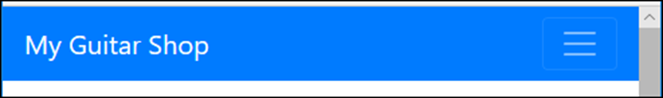
A navbar expanded on a wide screen
A navbar expanded on a small screen

Slide 58
The HTML for the navbar (part 1)
<nav class="navbar navbar-expand-md navbar-dark bg-primary">
<a class="navbar-brand" href="/">My Guitar Shop</a>
<button class="navbar-toggler" type="button"
data-toggle="collapse"
data-target="#navbarSupportedContent"
aria-controls="navbarSupportedContent"
aria-expanded="false"
aria-label="Toggle navigation">
<span class="navbar-toggler-icon"></span>
</button>
<nav class="collapse navbar-collapse"
id="navbarSupportedContent">
<div class="navbar-nav mr-auto">
<a class="nav-item nav-link active" href="/">Home</a>
<a class="nav-item nav-link"
href="/products">Products</a>
<a class="nav-item nav-link" href="/about">About</a>
</div>

Slide 59
The HTML for the navbar (part 2)
<div class="navbar-nav navbar-right">
<a class="nav-item nav-link" href="/cart">
<span class="fas fa-shopping-cart"></span>
&nbsp;Cart&nbsp;
<span class="badge badge-primary">2</span>
</a>
</div>
</nav>
</nav>

Slide 60
More CSS classes for positioning navbars
fixed-top
fixed-bottom

Slide 61
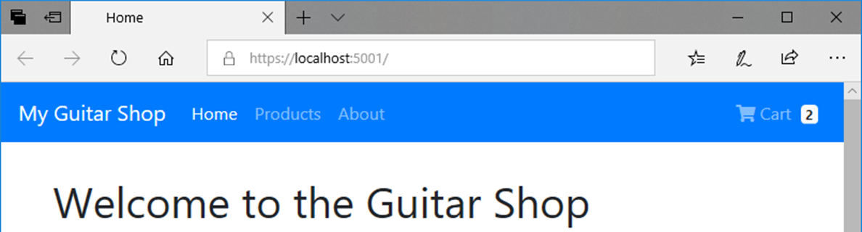
A navbar that’s fixed at the top of the screen

Slide 62
The HTML that displays the navbar
<body>
<nav class="navbar navbar-expand-md navbar-dark
bg-primary fixed-top">
<!-- navbar items go here -->
</nav>
<div class="container">
<!-- container items go here -->
</div>
</body>
The CSS that sets the top margin
body {
margin-top: 70px;
}

Slide 63
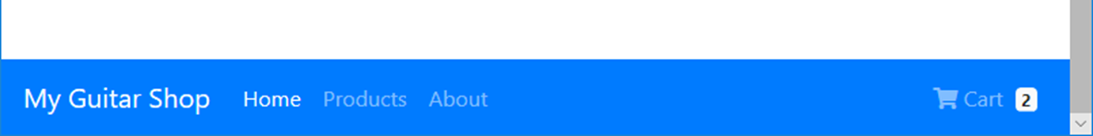
A navbar that’s fixed at the bottom of the screen

